Slide 1
Business Intelligence: A Managerial Perspective on Analytics
(3rd Edition)
Chapter 1:
An Overview on
Business Intelligence, Analytics
and Decision Support

Slide 2
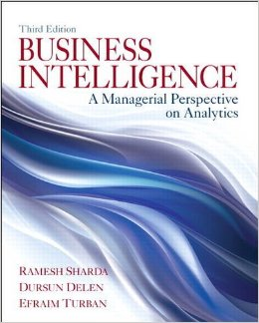
Plan of the Book
Introduction
Chapter 1
Data Foundations
Chapter 2
BI & Analytics
Chapters 3-6
Emerging Trends
Chapter 7

Slide 3
Learning Objectives
Understand today's turbulent business environment and describe how organizations survive and even thrive in such an environment (solving problems and exploiting opportunities)
Understand the need for computerized support of managerial decision making
Describe the business intelligence (BI) methodology and concepts
Understand the various types of analytics
Notes:
The environment in which organizations operate today are becoming more and more complex. The complexity of globalization for example creates many customers and suppliers in many countries, but with this also comes more and stronger competitors. The business environment factors can be divided into: markets, consumers, demand, technology, and societal. (page 7)

Slide 4
Changing Business Environment & Computerized Decision Support
Companies are moving aggressively to computerized support of their operations => Business Intelligence
Business Pressures–Responses–Support Model
Business pressures result of today's competitive business climate
Responses to counter the pressures
Support to better facilitate the process

Slide 5
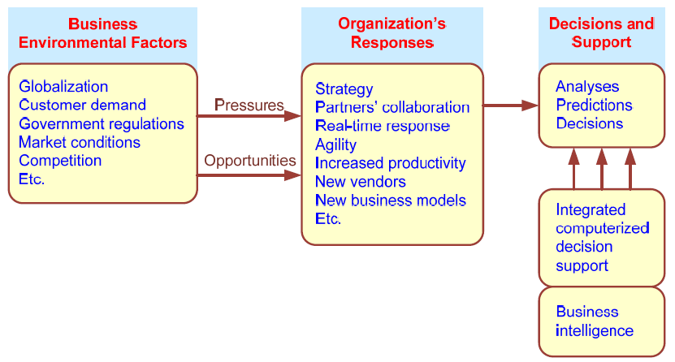
Business Pressures–Responses–Support Model
Notes:
Three components: business pressures that result from today’s business climate; responses by companies to counter the pressures; and computerized support that facilitates the monitoring.

Slide 6
The Business Environment
The environment in which organizations operate today is becoming more and more complex, creating:
opportunities, and
problems.
Example: globalization
You can find suppliers and customers worldwide
Means cheaper materials and greater opportunities
Leads to more pressures, more competition

Slide 7
Business Environment Factors
FACTOR DESCRIPTION
Markets Strong competition
Expanding global markets
Blooming electronic markets on the Internet
Innovative marketing methods
Opportunities for outsourcing with IT support
Need for real-time, on-demand transactions
Consumer Desire for customization
demand Desire for quality, diversity of products, and speed of delivery
Customers getting powerful and less loyal
Technology More innovations, new products, and new services
Increasing obsolescence rate
Increasing information overload
Social networking, Web 2.0 and beyond
Societal Growing government regulations and deregulation
Workforce more diversified, older, and composed of more women Prime concerns of homeland security and terrorist attacks
Necessity of Sarbanes-Oxley Act and other reporting-related legislation Increasing social responsibility of companies
Greater emphasis on sustainability
Notes:
The intensity of most of these factors increase over time, leading to more pressures, more competition, etc. Organizations face decreased budgets and amplified pressures from top managers to increase performance and profit.

Slide 8
Organizational Responses
Be Reactive, Anticipative, Adaptive, and Proactive
Managers may take actions, such as:
Employing strategic planning.
Using new and innovative business models.
Restructuring business processes.
Participating in business alliances.
Improving corporate information systems.
Improving partnership relationships.
Encouraging innovation and creativity. …cont…>
Notes:
Strategic Planning: a companies goals can help build a long term strategy.

Slide 9
Organizational Responses, continued
Improving customer service and relationships.
Moving to electronic commerce (e-commerce).
Moving to make-to-order production and on-demand manufacturing and services.
Using new IT to improve communication, data access (discovery of information), and collaboration.
Responding quickly to competitors' actions (e.g., in pricing, promotions, new products and services).
Automating many tasks of white-collar employees.
Automating certain decision processes.
Improving decision making by employing analytics.
Notes:
Make-to-Order: manufacturing starts only when a customer’s order is received, i.e. wait till demand increases to “pull” the company into making more of it’s product.

Slide 10
Closing the Strategy Gap
Main objective of computerized decision support
Close the gap between an organization’s current performance and desired performance, as expressed in its mission, objectives, and goals, and the strategy put forth to achieve them.

Slide 11
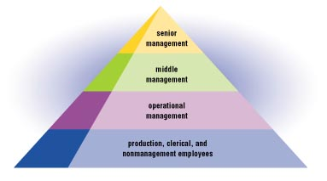
“Traditional” Organizational Hierarchy
Strategic Mgmt Software (Exec IS or EIS)
Strategic Decisions
Tactical Mgmt Software (Mgmt. IS or MIS)
Tactical Decisions
Operational Decisions
Operational Mgmt Software
(Transaction Processing System – TPS)
Notes:
Transaction Processing System:
Strategic management vs Tactical Management:

Slide 12
Business Intelligence (BI)
BI is an evolution of decision support concepts over time.
Meaning of EIS/DSS…
Then: Executive Information System
Now: Everybody’s Information System (BI)
http://services.flhsmv.gov/PerformanceDashboard/StrategicGoals.aspx
BI systems are enhanced with additional visualizations, alerts, and performance measurement capabilities.
The term BI emerged from industry apps.

Slide 13
Definition of BI
BI is an umbrella term that combines architectures, tools, databases, analytical tools, applications, and methodologies.
BI a content-free expression, so it means different things to different people.
BI's major objective is to enable easy/ interactive access to data (and models) to provide business managers with the ability to conduct analysis.
BI helps transform data, to information (and knowledge), to decisions and finally to actions.
Notes:
Difference between data and information:
Information is formed after an analysis of data. Data is unorganized.

Slide 14
A Brief History of BI
The term BI was coined by the Gartner Group in the mid-1990s
However, the concept is much older
1970s — MIS reporting — static/periodic reports
1980s — Executive Information Systems (EIS)
1990s — OLAP, dynamic, multidimensional, ad-hoc reporting -> coining of the term “BI”
2005+ — Introduction of AI and Data/Text Mining capabilities
2010s - Data/Text/Web Mining; Web-based Portals, Dashboards, Big Data, Social Media, and Visual Analytics
2020s - yet to be seen
Notes:
OLAP: Online Analytical Processing
Adhoc: generate a table based on other data. The table doesn’t exist (think SQL).
MIS: Management Information System

Slide 15
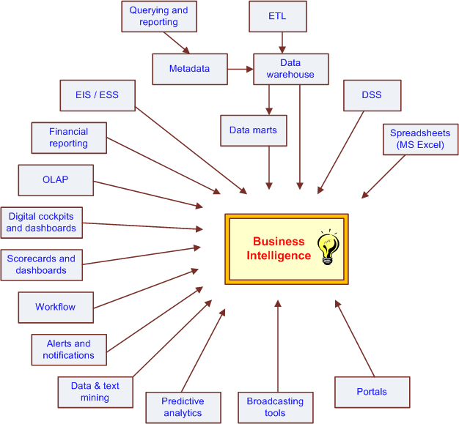
The Evolution of BI Capabilities
Notes:
Decision Support System

Slide 16
The Architecture of BI
A BI system has four major components:
a data warehouse, with its source data
business analytics, a collection of tools for manipulating, mining, and analyzing the data in the data warehouse;
business performance management (BPM) for monitoring and analyzing performance
a user interface (e.g., dashboard)

Slide 17
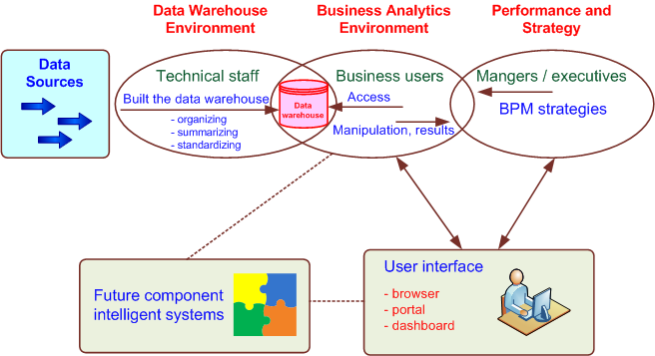
A High-level Architecture of BI

Slide 18



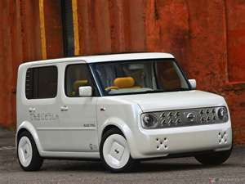





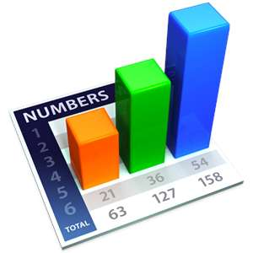
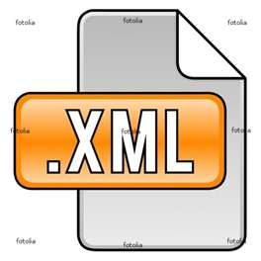



Transforming Data into Information
Ken’s Take on Microsoft’s BI Model
SharePoint Portal
DW
DM
DM
Notes:
A cube is a data structure that contains all the information of whatever…
“Dimensions” offer different ways of viewing the data.
Data Charts can come from DW, DM, Cubes,..
Portals help coordinate input and output of data. Power users (Charlie Sheen) can get info directly out of the cube as well as the portal.
Data is output from the data warehouse as often as the user requests it (think facebook)

Slide 19
Components in a BI Architecture
The data warehouse is the cornerstone of any medium-to-large BI system.
Originally, the data warehouse included only historical data that was organized and summarized, so end users could easily view or manipulate it.
Today, some data warehouses include access to current data as well, so they can provide real-time decision support (for details see Chapter 2).
Business analytics are the tools that help users transform data into knowledge (e.g., queries, data/text mining tools, etc.).

Slide 20
Components in a BI Architecture
Business Performance Management (BPM),
AKA corporate performance management (CPM)
A portfolio of BI applications that provides enterprises tools they need to better manage their operations (more in Chapter 3).
User Interface (i.e., dashboards) provides a comprehensive graphical/pictorial view of corporate performance measures, trends, and exceptions.
Dashboard that I created for Highway Safety Motor Vehicles
http://services.flhsmv.gov/PerformanceDashboard/StrategicGoals.aspx

Slide 21
Application Case 1.1
Sabre Helps Its Clients Through Dashboards and Analytics
Questions for Discussion
What is traditional reporting? How is it used in the organization?
How can analytics be used to transform the traditional reporting?
How can interactive reporting assist organizations in decision making?
Notes:
Sabre helps its clients through dashboards and analytics. They are leaders in the travel industry providing services of business-to-consumer and business-to-business.
It is the manual, time consuming process of gathering financial data and other information needed for actionable initiatives. Traditional reporting is usually a once a week, 8 hour process.
Analytics eliminate traditional reporting by releasing information provided by the data as quickly as every 15 minutes for large data warehouses.
There is more direct access to data. Dashboards provide interactive views and eliminate having more presentations since more of the companies relations are able to view the almost real time data analysis.

Slide 22
A Multimedia Exercise in Business Intelligence
Teradata University Network (TUN)
www.teradatauniversitynetwork.com
BSI Videos (Business Scenario Investigations)
www.youtube.com/watch?v=NXEL5F4_aKA
How Teradata accomplished this task
http://www.slideshare.net/teradata/bsi-how-we-did-it-the-case-of-the-misconnecting-passengers
Also look for other BSI Videos at TUN

Slide 23
The Benefits of BI
The ability to provide accurate information when needed, including a real-time view of the corporate performance and its parts
A survey by Thompson (2004)
Faster, more accurate reporting (81%)
Improved decision making (78%)
Improved customer service (56%)
Increased revenue (49%)

Slide 24
The Benefits of BI
Analytic Application | Question | Value
Customer Segmentation | What market segments do my customers fall into, and what are their characteristics? | Personalize customer relationships for higher satisfaction and retention
Propensity to Buy | Which customers are most likely to respond to my promotion? | Target customers based on their need to increase their loyalty to your product line
Customer Profitability | What is the lifetime profitability of my customer? | Make individual business interaction decisions based on the overall profitability of customers
Fraud Detection | How can I tell which transactions are likely to be fraudulent? | Quickly determine fraud and take immediate action to minimize cost
Customer Attrition | Which customer is at risk of leaving? | Prevent loss of high-value customers and let go of lower-value customers
Channel Optimization | What is the best channel to reach my customer in each segment? | Interact with customers based on their preference and your need to manage costs

Slide 25
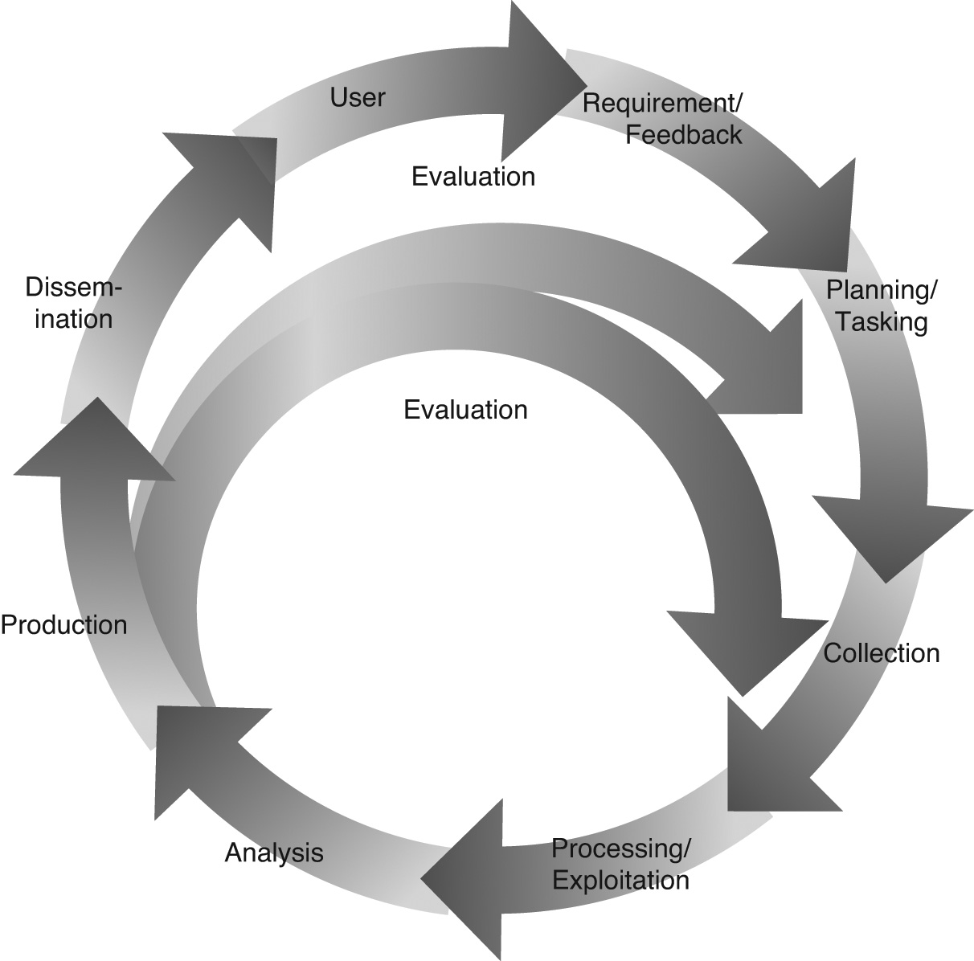
Intelligence Creation, Use and BI Governance
A Cyclical Process of Intelligence Creation And Use
Data warehouse and BI initiatives typically follow a process similar to that used in military intelligence initiatives.

Slide 26
Analytics
“Analytics” has replaced the previous individual components of computerized decision support systems (DSS)
Analytics now the sexier term rather than BI.
The process of developing actionable decisions or recommendations for actions based upon insights generated from historical data.
3 Levels of Analytics

Slide 27
Analytics Overview

Slide 28
Opening Vignette…
Magpie Sensing Employs Analytics to Manage a Vaccine Supply Chain Effectively and Safely
Company background
Problem
Proposed solution and results
Answer & discuss the case questions

Slide 29
Opening Vignette…
Questions for the Opening Vignette
What information is provided by the descriptive analytics employed at Magpie Sensing?
What type of support is provided by the predictive analytics employed at Magpie Sensing?
How does prescriptive analytics help in business decision making?
In what ways can actionable information be reported in real time to concerned users of the system?
In what other situations might real-time monitoring applications be needed?
Notes:
The wireless temperature and humidity sensors monitors the set point of the storage system’s thermostat, the typical range of the temperature values, and the duty cycle of the system’s compressor. These I think are examples of descriptive analytics.
The predictive analytics algorithms can determine the set point of the storage’s thermostat and alert the users of a incorrectly configured system depending on the product stored. It also alerts about possible temperature violations based on the storage unit’s average temperature and subsequent compressor cycles. Also by analyzing temperature trends, human errors can be reported such as when the storage system is noted to not be shut down.
Prescriptive analytics can improve the cold storage processes. It would help users dial in the optimal temperature setting. In the case of power loss, the algorithm can determine how much time before spoilage occurs. These analytics also gather meta-information including times of day that are busiest or when the system’s doors are open. This will help maintain the systems better and make sure they are no overused. It helps guide equipment to be purchased base on the system’s performance.
The information on the system can be reported through web interface, text message, or an audio device.
Real time monitoring can be used for tracking nearby weather conditions or the count of times the storage unit has been opened.

Slide 30
Intelligence Creation and Use
Steps Involved
Data warehouse deployment
Creation of intelligence
Identification and prioritization of BI projects
By using ROI and TCO (cost-benefit analysis)
This process is also called…
BI Governance
Who should serve as decision makers involved in prioritizing BI projects.
Partnership between functional area heads?
Partnership between customers and providers?

Slide 31
BI Governance Issues/Tasks
Create categories of projects (investment, business opportunity, strategic, mandatory, etc.)
Define criteria for project selection
Determine and set a framework for managing project risk
Manage and leverage project interdependencies
Continuously monitor and adjust the composition of the portfolio

Slide 32
Intelligence vs. Espionage
Stealing corporate secrets, CIA, …
Intelligence vs. Espionage
Intelligence
The way that modern companies ethically and legally organize themselves to glean as much as they can from:
their customers
their business environment
their stakeholders
their business processes
their competitors and other such sources of potentially valuable information
Espionage
obtaining information considered secret or confidential without the permission of the holder of the information (MI5)

Slide 33
Transaction Processing Versus Analytic Processing
Transaction processing systems are constantly involved in handling updates (add/edit/delete) to what we might call operational databases.
ATM withdrawal transaction, sales order entry via an ecommerce site – updates DBs
Online transaction processing (OLTP) handles routine on-going business
ERP, SCM, CRM systems generate and store data in OLTP systems
The main goal is to have high efficiency

Slide 34
Transaction Processing Versus Analytic Processing
Online analytic processing (OLAP) systems are involved in extracting information from data stored by OLTP systems
Routine sales reports by product, by region, by salesperson, etc.
Often built on top of a data warehouse where the data is not transactional
Main goal is effectiveness (and then, efficiency) – provide correct information in a timely manner
More on OLAP will be covered in Chapter 2

Slide 35
Successful BI Implementation
Implementing and deploying a BI initiative is a lengthy, expensive and risky endeavor!
Success of a BI system is measured by its widespread usage for better decision making.
The typical BI user community includes
All levels of the management hierarchy (not just the top executives, as was for EIS)
Provide what is needed to whom he/she needs it
The book says, “A successful BI system must be of benefit to the enterprise as a whole.” or should it?

Slide 36
BI – Aligned with Business Strategy
To be successful, BI must be aligned with the company’s business strategy.
BI cannot/should not be a technical exercise for the information systems department.
BI changes the way a company conducts business by
improving business processes, and
transforming decision making to a more data/fact/information driven activity.
BI should help execute the business strategy and not be an impediment for it!

Slide 37
BI for Business Strategy
Strategy should be aligned with BI/DW – has the capability to execute the initiative by establishing a BI Competency Center (BICC) which can:
Demonstrate linkage – BI to strategy.
Encourage interaction between the potential business users and the IS organization.
Both sides have a lot to learn from each other
Serve as a repository and disseminator of best BI practices among the different lines of business.
Advocate and encourage standards of excellence.
Help stakeholders understand the crucial role of BI.

Slide 38
Real-time, On-demand BI
Traditional view of Data Warehousing
It’s ideal for reporting on data that may be hours or days old
The demand for “real-time” BI is growing!
Instantaneous data integration to aid in notifications, warnings, decisions
What kind of technologies allow for real-time
What things can happen in real-time that you would want to know about
Is “real-time” BI attainable?
Technology is getting there…
Automated, faster data collection (RFID, sensors,… )
Database and other software technologies (agent, SOA, …) are advancing
Telecommunication infrastructure is improving
Computational power is increasing
Cost for these technologies is decreasing
BSI Videos (Business Scenario Investigations)
www.youtube.com/watch?v=NXEL5F4_aKA

Slide 39
Issues for Successful BI
Developing vs. Acquiring BI systems
Developing everything from scratch
Buying/leasing a complete system
Using a shell BI system and customizing it
Use of outside consultants?
Justifying via cost-benefit analysis
It is easier to quantify costs
Harder to quantify benefits
Most of them are intangibles
Both tangible and intangible benefits need to be identified and quantified if possible

Slide 40
Issues for Successful BI
Security and Privacy
Still an important research topic in BI
How much security/privacy do you need?
Integration of Systems and Applications
BI must integrate into the existing IS
Often sits on top of ERP, SCM, CRM systems
Integration to outside (partners of the extended enterprise) via internet –
customers, vendors, government agencies, etc.

Slide 41
Application Case 1.2
Eliminating Inefficiencies at Seattle Children’s Hospital
Questions for Discussion
Who are the users of the tool?
What is a dashboard?
How does visualization help in decision making?
What are the significant results achieved by the use of Tableau?
Notes:
1.

Slide 42
Application Case 1.3
Analysis at the Speed of Thought
Questions for Discussion
What are the desired functionalities of a reporting tool?
What advantages were derived by using a reporting tool in the case?

Slide 43
Application Case 1.4
Moneyball: Analytics in Sports and Movies
Questions for Discussion
How is predictive analytics applied in Moneyball?
What is the difference between objective and subjective approaches in decision making?

Slide 44
Application Case 1.5
Analyzing Athletic Injuries
Questions for Discussion
What types of analytics are applied in the injury analysis?
How do visualizations aid in understanding the data and delivering insights into the data?
What is a classification problem?
What can be derived by performing sequence analysis?

Slide 45
Application Case 1.6
Industrial and Commercial Bank of China Employs Models to Reconfigure Its Branch Networks
Questions for Discussion
How can analytical techniques help organizations to retain competitive advantage?
How can descriptive and predictive analytics help in pursuing prescriptive analytics?
What kind of prescriptive analytic techniques are employed in the case study?
Are the prescriptive models once built good forever?

Slide 46
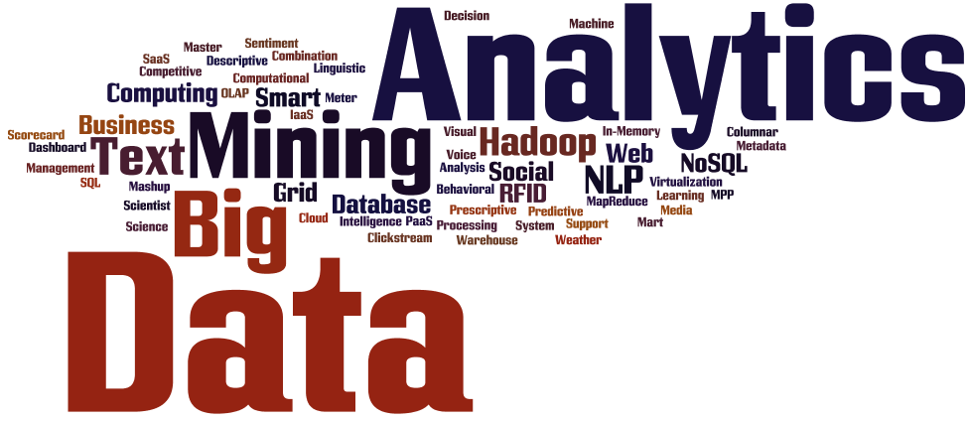
Introduction to Big Data Analytics
Big Data?
Not just big!
Volume
Variety
Velocity
More on big data and related analytics tools and techniques are covered in Chapter 6.

Slide 47
Application Case 1.7
Gilt Groupe’s Flash Sales Streamlined by Big Data Analytics
Questions for Discussion
What makes this case study an example of Big Data analytics?
What types of decisions does Gilt Groupe have to make?

Slide 48
End-of-Chapter Application Case
Nationwide Insurance Used BI to Enhance Customer Service
Questions for Discussion
Why did Nationwide need an enterprise-wide data warehouse?
How did integrated data drive the business value?
What forms of analytics are employed at Nationwide?
With integrated data available in an enterprise data warehouse, what other applications could Nationwide potentially develop?

Slide 49
End of the Chapter
Questions / Comments…

